Slide 1




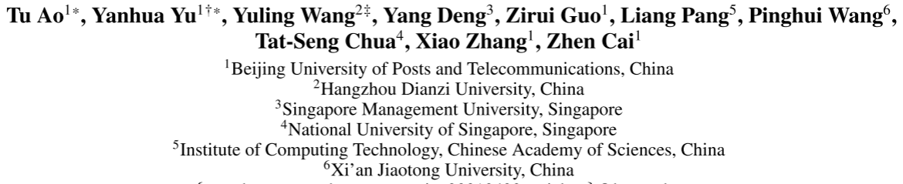





ATAI
Advanced Technique of Artificial Intelligence
ATAI
ChongqingUniversity _{AdvancedTechniqueof}
of Technology Artificial Intelligence
Chongqing University of
Technology
Chongqing University ^{ATAI}
_{of Technology} Advanced Techniqueof
Artificial Intelligence
Chongqing University of Technology
Chongqing University of Technology
LightPROF: A Lightweight Reasoning Framework for Large Language Model on Knowledge Graph
Code:https://github.com/Mathews-Tom/LightPROF
——WWW_2025
Reported by Long Zhang

Slide 2
ATAI
Advanced Technique of Artificial Intelligence
ATAI
ChongqingUniversity _{AdvancedTechniqueof}
of Technology Artificial Intelligence
Chongqing University of
Technology
Chongqing University ^{ATAI}
_{of Technology} Advanced Techniqueof
Artificial Intelligence
Chongqing University of Technology
Chongqing University of Technology
Motivation
1) LLM updates knowledge slowly in knowledge graph Q & A.
2) LLM does not effectively use KG structure information.
3) The problem of high resource consumption
The aim is to design a lightweight and efficient framework so that small-scale LLM can combine knowledge graphs to complete reasoning with low cost and high precision.

Slide 3
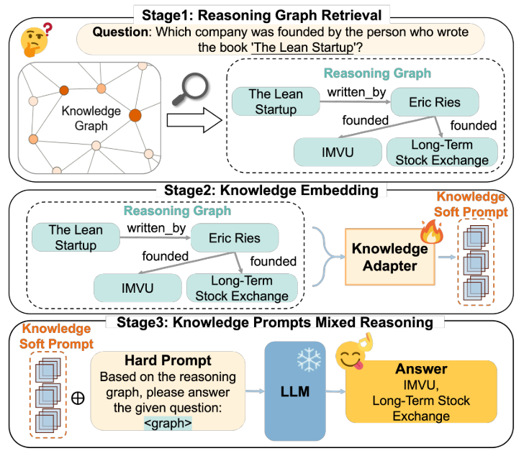
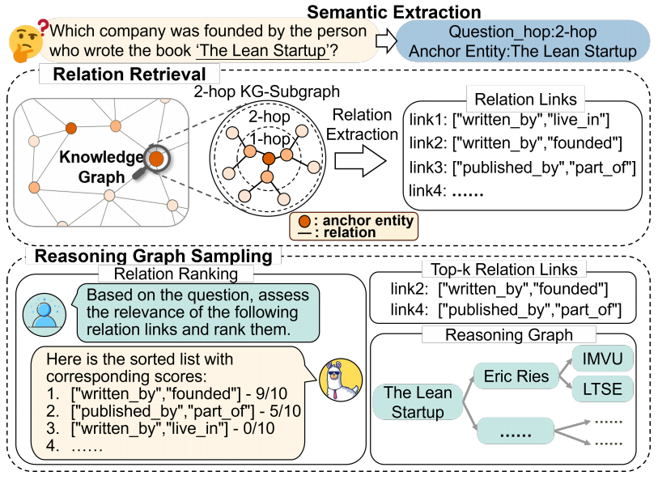
ATAI
Advanced Technique of Artificial Intelligence
ATAI
ChongqingUniversity _{AdvancedTechniqueof}
of Technology Artificial Intelligence
Chongqing University of
Technology
Chongqing University ^{ATAI}
_{of Technology} Advanced Techniqueof
Artificial Intelligence
Chongqing University of Technology
Chongqing University of Technology
Method

Slide 4
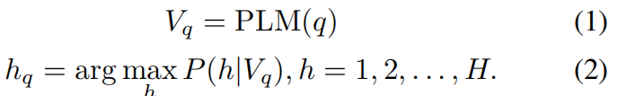
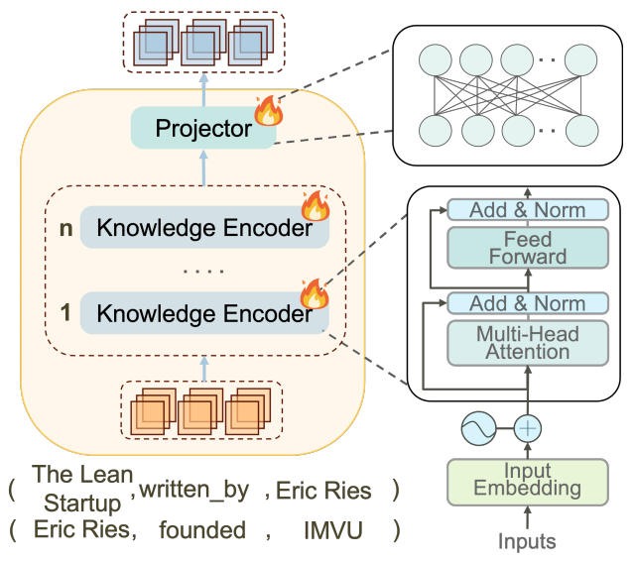


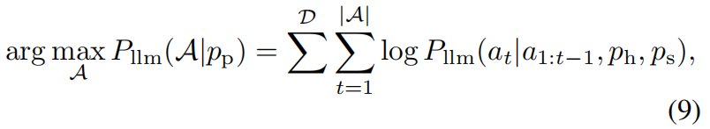
ATAI
Advanced Technique of Artificial Intelligence
ATAI
ChongqingUniversity _{AdvancedTechniqueof}
of Technology Artificial Intelligence
Chongqing University of
Technology
Chongqing University ^{ATAI}
_{of Technology} Advanced Techniqueof
Artificial Intelligence
Chongqing University of Technology
Chongqing University of Technology
Method

Slide 5
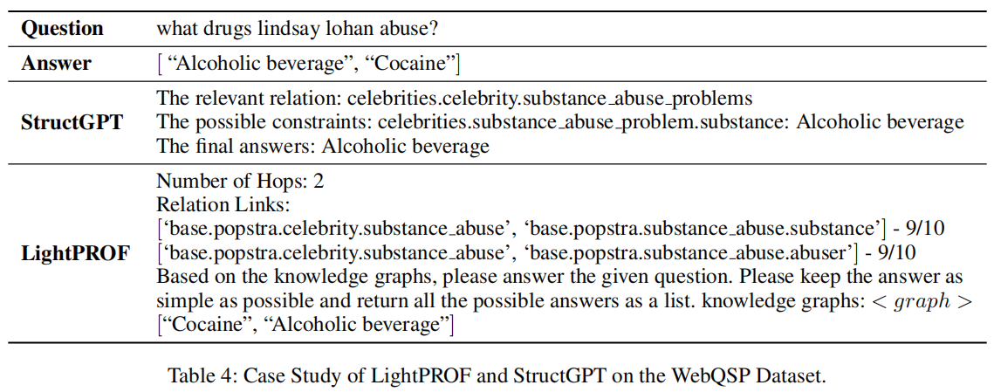
ATAI
Advanced Technique of Artificial Intelligence
ATAI
ChongqingUniversity _{AdvancedTechniqueof}
of Technology Artificial Intelligence
Chongqing University of
Technology
Chongqing University ^{ATAI}
_{of Technology} Advanced Techniqueof
Artificial Intelligence
Chongqing University of Technology
Chongqing University of Technology
Method

Slide 6
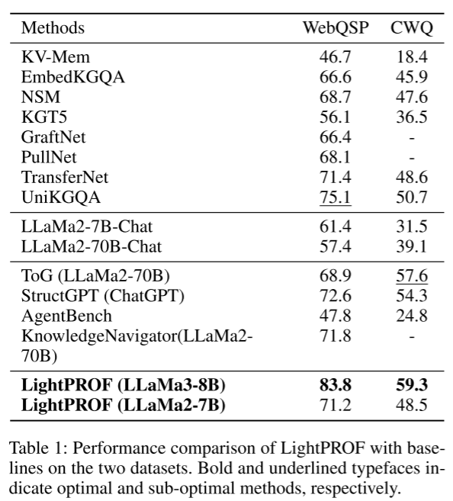
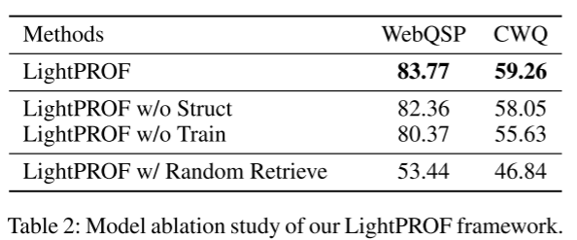
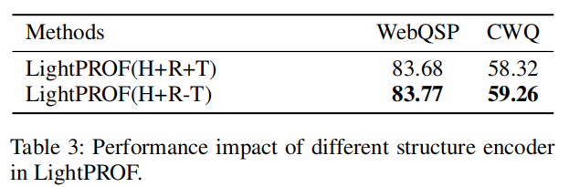
ATAI
Advanced Technique of Artificial Intelligence
ATAI
ChongqingUniversity _{AdvancedTechniqueof}
of Technology Artificial Intelligence
Chongqing University of
Technology
Chongqing University ^{ATAI}
_{of Technology} Advanced Techniqueof
Artificial Intelligence
Chongqing University of Technology
Chongqing University of Technology
Experiments

Slide 7
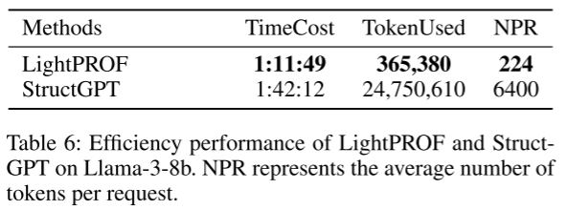
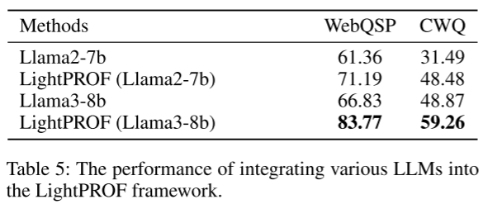
ATAI
Advanced Technique of Artificial Intelligence
ATAI
ChongqingUniversity _{AdvancedTechniqueof}
of Technology Artificial Intelligence
Chongqing University of
Technology
Chongqing University ^{ATAI}
_{of Technology} Advanced Techniqueof
Artificial Intelligence
Chongqing University of Technology
Chongqing University of Technology
Experiments

Slide 8


ATAI
Advanced Technique of Artificial Intelligence
ATAI
ChongqingUniversity _{AdvancedTechniqueof}
of Technology Artificial Intelligence
Chongqing University of
Technology
Chongqing University ^{ATAI}
_{of Technology} Advanced Techniqueof
Artificial Intelligence
Chongqing University of Technology
Chongqing University of Technology
Thanks!

